Slide 1

It’s cold in here with all this food! Come find me and I will lighten your mood.

Slide 2

I am somewhere the dishes get clean. Press the button, and I’ll be covered in steam!
9
1 FRIDGE

Slide 3
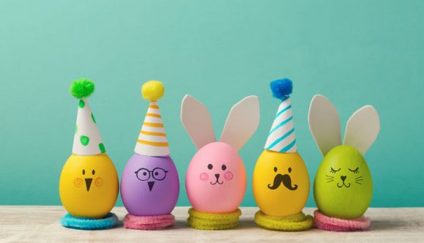
You are doing great, now let’s find more. You’ll find me in the silverware drawer!
4
2 DISHWASHER

Slide 4
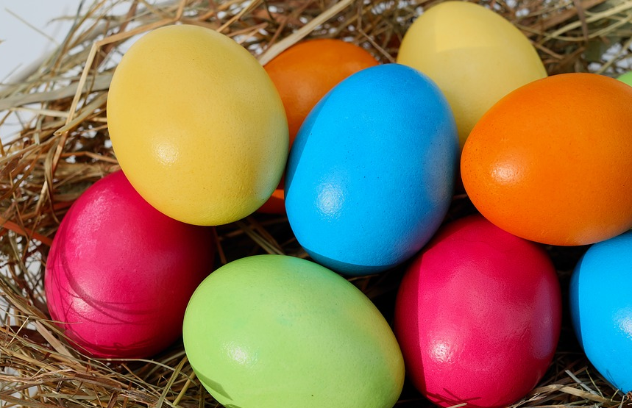
I am under the spot where you can eat. Pool out the chairs and look under the lid.
4
3 DRAWER

Slide 5

This one is smelly like skunks' bed chamber Find me at the back, and you’ll get your next number!
1
4 TABLE LID

Slide 6
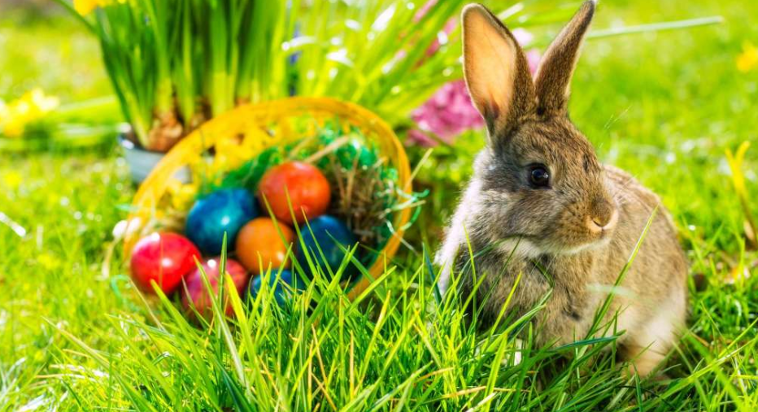
You have almost earned your Easter Egg! Find me tied to this tall thing’s leg.
5
4 BIN

Slide 7
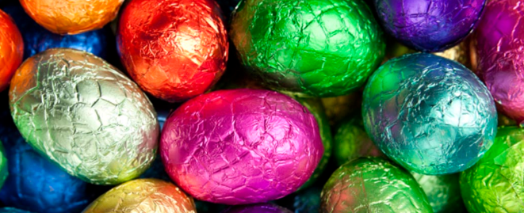
Excellent job, very well done! You have now found the very last one.
2
5 STOOL

